Slide 1
CASE STUDY 3
BY
AUSTIN ,
DHANSHRI ,
NIKHILA ,
SALONI,
SWAROOP

Slide 2
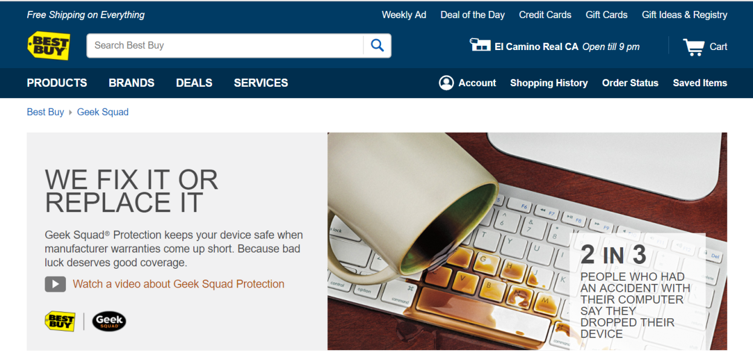
Background and Research Question
Background
Companies like Best Buy sell bundled products to increase profits.
Best Buy focuses on warranty sales i.e. the Geek Squad protection plan
Research Question
Identify customers who have high propensity to purchase the protection plan , so we can provide
a data driven proposal for a potential marketing strategy

Slide 3
Key Variables & Control Variables
Dependent variable : Warranty
Key Independent Variable : PriceCategory*appliances,hisp,hhincome,familysize
Control variables : age, newcustomer, weekend , MyBestBuy
Theoretical Model
Warranty ~ β₀ + β₁PriceCategory*Appliances + β₂Age + β₃Hispanic + β₄MyBestBuy + β₅Income + β₆FamilySize + β₇Weekend + β₈NewCustomer+β₉ Pricecategory + β₁₀ Appliances

Slide 4
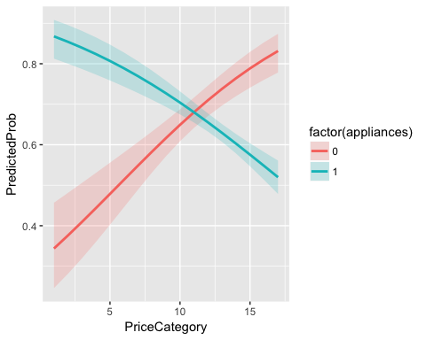
Insights
Home appliance products have 35 percentage points higher likelihood of buying warranty in lower price category compared to higher price category.
Non- home appliance products have 49 percentage points higher likelihood of buying warranty in higher price category compared to lower price category.

Slide 5
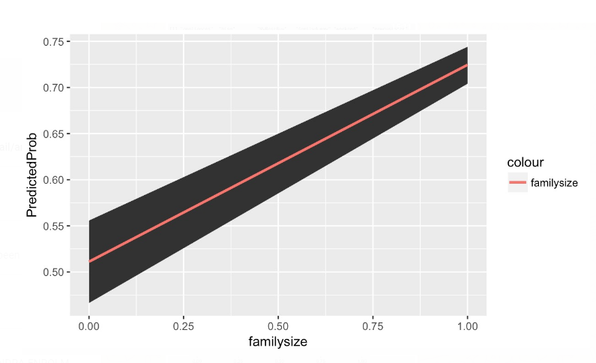
Insights
A customer with a family of 3 - 4 members has 21 percentage points higher likelihood of buying warranty compared to a customer with a family of 1-2 members.

Slide 6
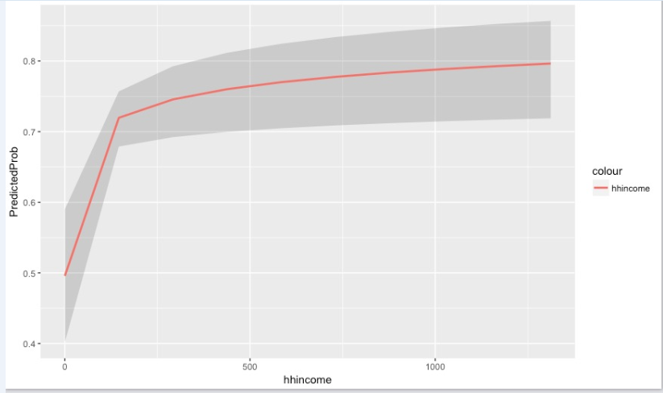
Insight
The higher the income of a customer , the higher the likelihood of purchasing warranty.

Slide 7
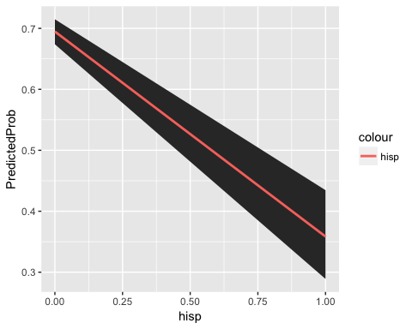
Insight
Non - Hispanic customers have 34 percentage points higher likelihood of buying warranty compared to the Hispanic customers.

Slide 8
Marketing Strategy Proposal
Customers centric strategy:
High income
Non-Hispanic
Family size 3 and 4
Product centric strategy :
Home appliances that have low prices
Non-home appliances that have high prices.

Slide 9
Limitations
Biased data :
For example :
Relatively small sample size.
Only includes customers between the ages 52 and 86.
Family size only goes up to 4 .
There are many other variables that could strengthen our model (yearly data , holiday data, additional data, etc.)
Model accuracy is only 68.24 % .
Because of which we need to be cautious about our proposal.

Slide 10
THANK YOU

Slide 11
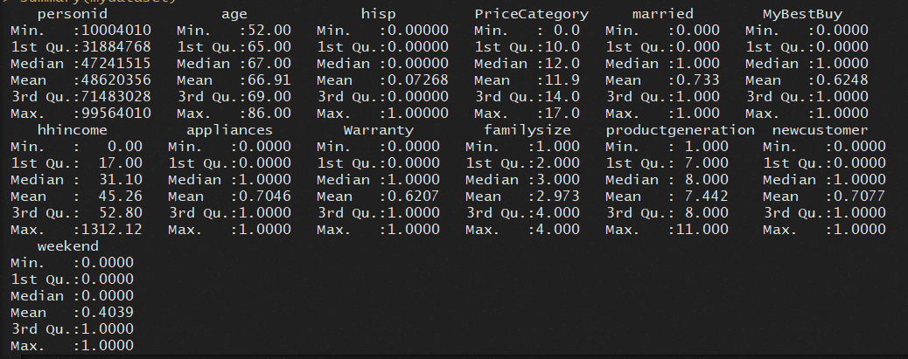
Appendix
Summary Statistics
E.g. Mostly retired (or in age group ~52-86)

Slide 12
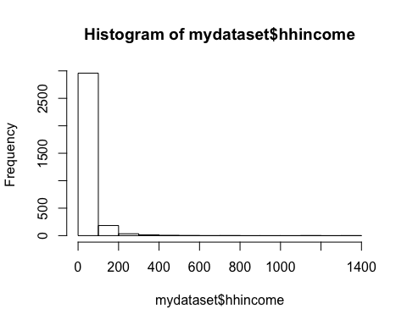
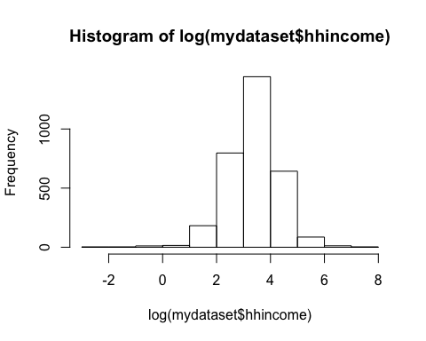
Histogram of hhincome and log(hhincome)

Slide 13
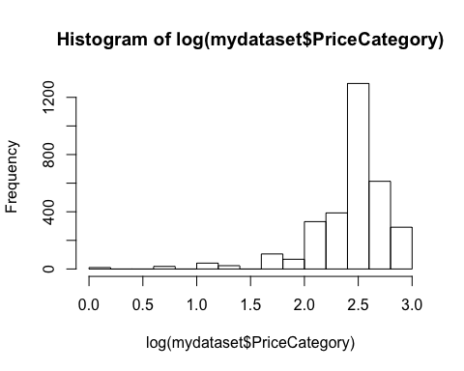
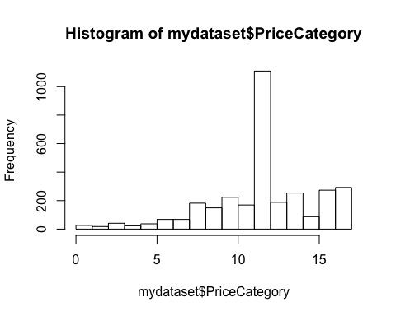
Histogram of price category and log( price category)

Slide 14
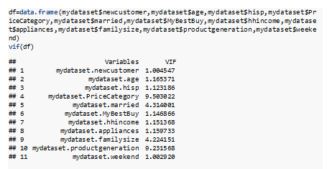
VIF test for DF

Slide 15
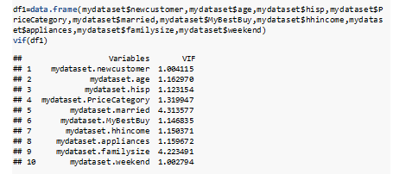
VIF TEST FOR DF1

Slide 16

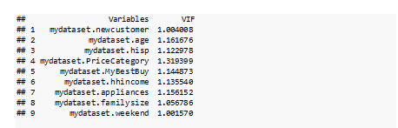
VIF TEST FOR DF2

Slide 17

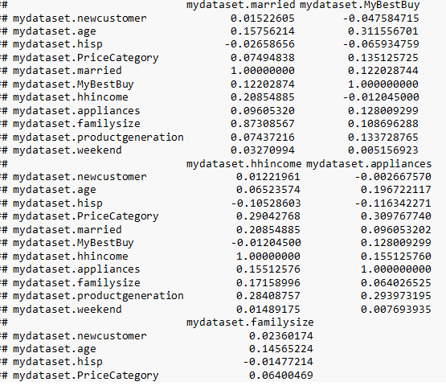
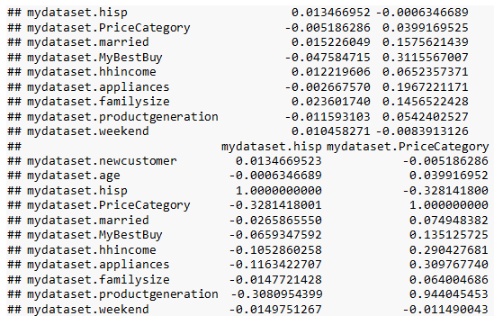
Correlation Matrix

Slide 18
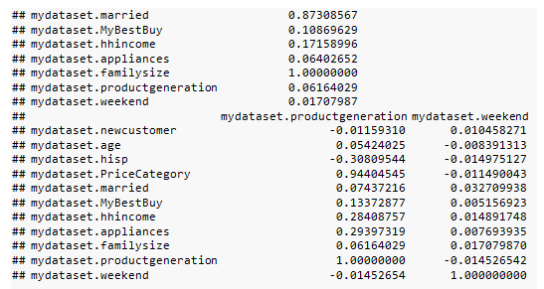
Correlation

Slide 19
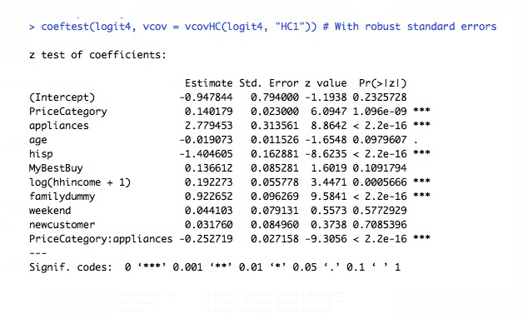
Final model (Logit) with robust standard errors.

Slide 20
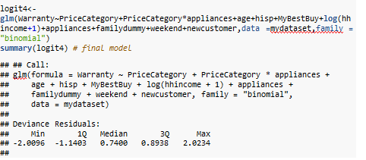
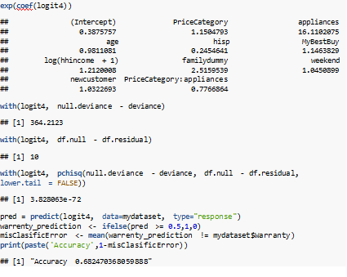
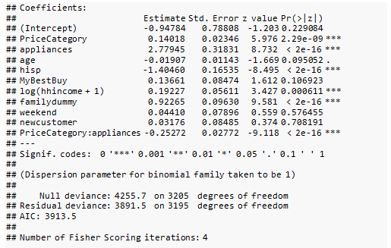
Our final model Logit

Slide 21
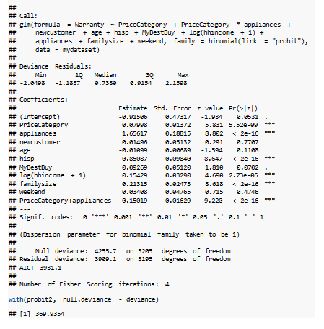
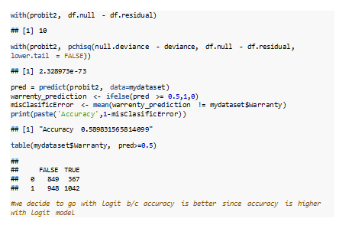
Our final model - Probit

Slide 22
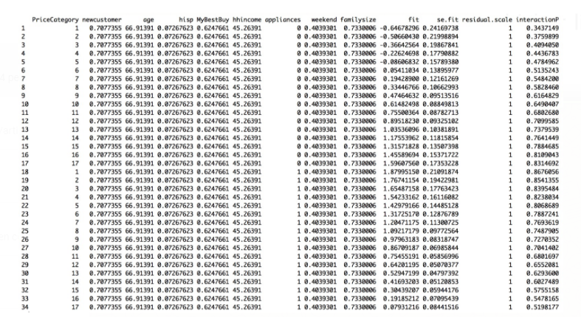
Predicted Probability – Interaction term

Slide 23
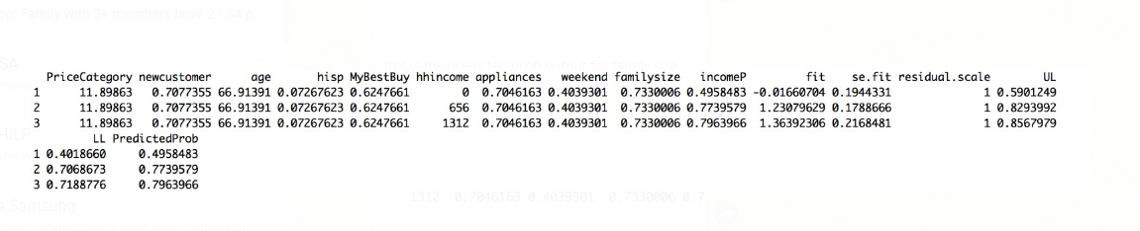
Predicted Probability – three income levels

Slide 24
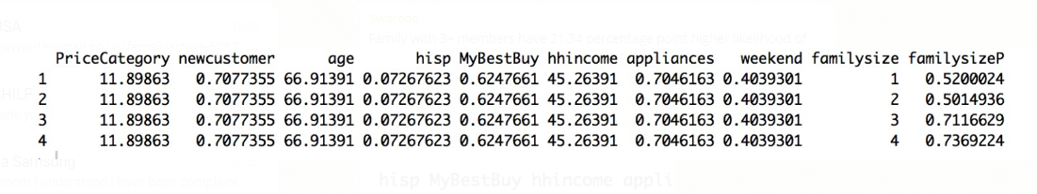
Grouping of Family Size

Slide 25

Family factor (logit 4) vs Family dummy (logit 8)

Slide 26
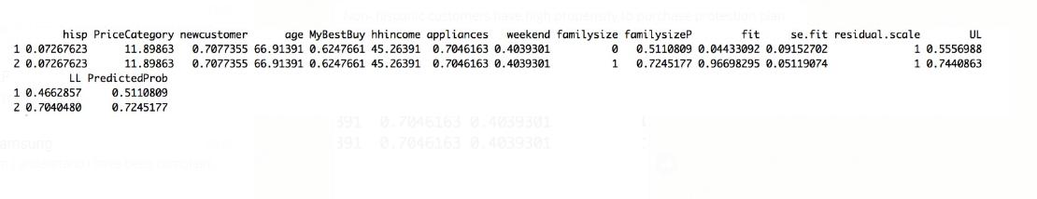
Predicted Probability – Family Size

Slide 27
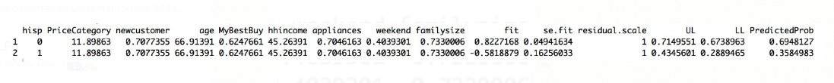
Predicted Probabilty – Hispanic Customers

Slide 28
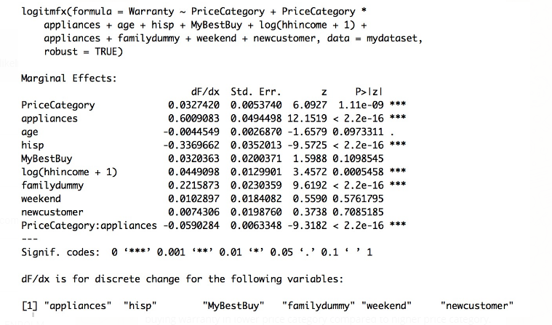
Marginal Effects

Slide 29
Data Snapshot
Customer Demographics
Customer Behavior
Product Description

